Slide 1
Advanced Image Analysis
a.a. 2017-2018, 2nd semester
Project
Pectoral Muscle Segmentation in Digital Mammograms
Alessandro Bria
Contract Professor
and Post-doc Researcher
email: a.bria@unicas.it

Slide 2
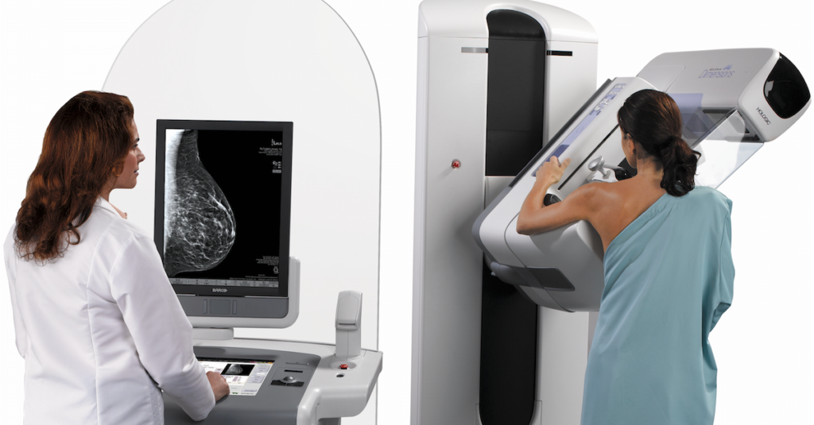
Motivations
X-ray mammography is a widely used method to screen women for early detection of breast cancer
Computer Aided Diagnosis (CAD) helps radiologists in interpreting screening mammograms
the pectoral muscles have pixel intensities and texture similar to that of breast tissues
this may lead to false positive CAD findings
the pectoral muscle has to be segmented from the mammogram for an effective automated CAD

Slide 3
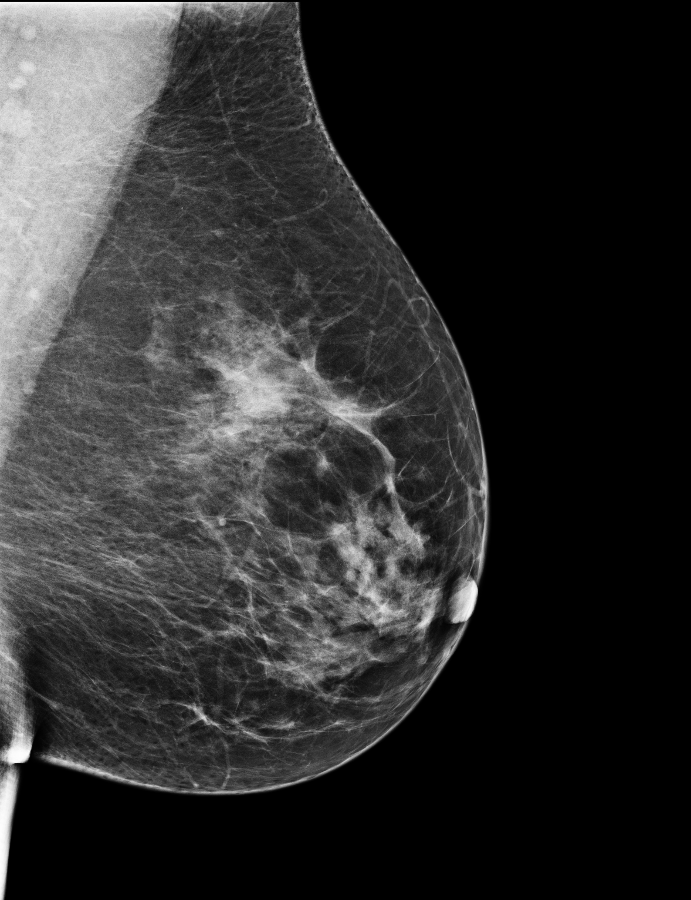

Goal
implement a reusable module for automated pectoral muscle segmentation
a must-have module in most CAD systems
pectoral muscle segmentation
microcalcification detection
mass detection
...
input images
CAD system
binary images

Slide 4

Materials
INBREAST dataset (188 images) containing:
mammograms (16-bit)
/dataset/images
breast-air masks
/dataset/masks
manual annotations
/dataset/groundtruths

Slide 5
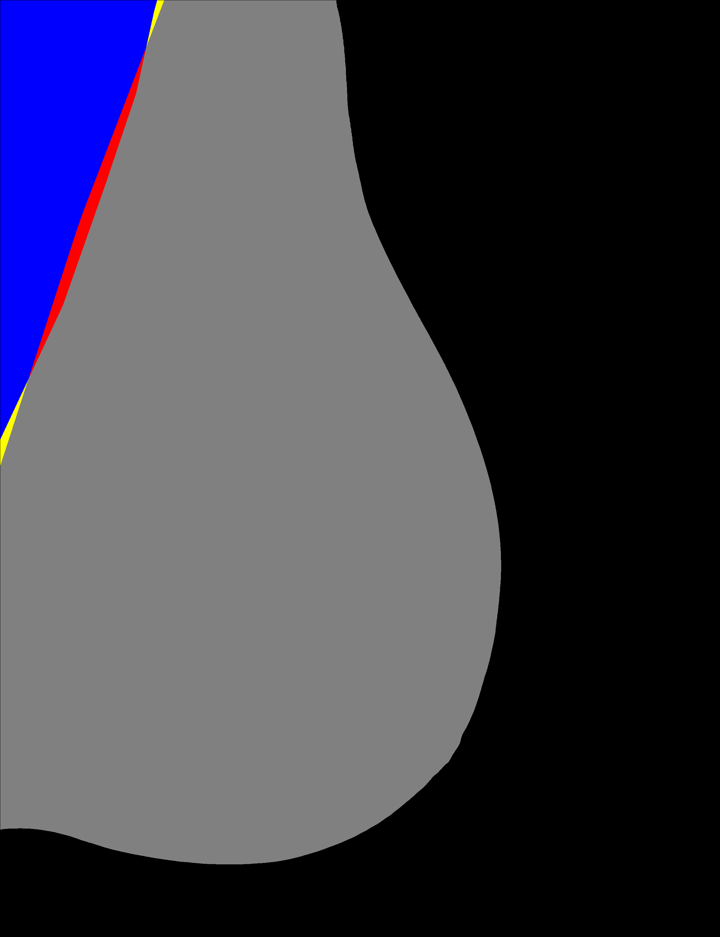
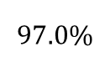
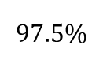
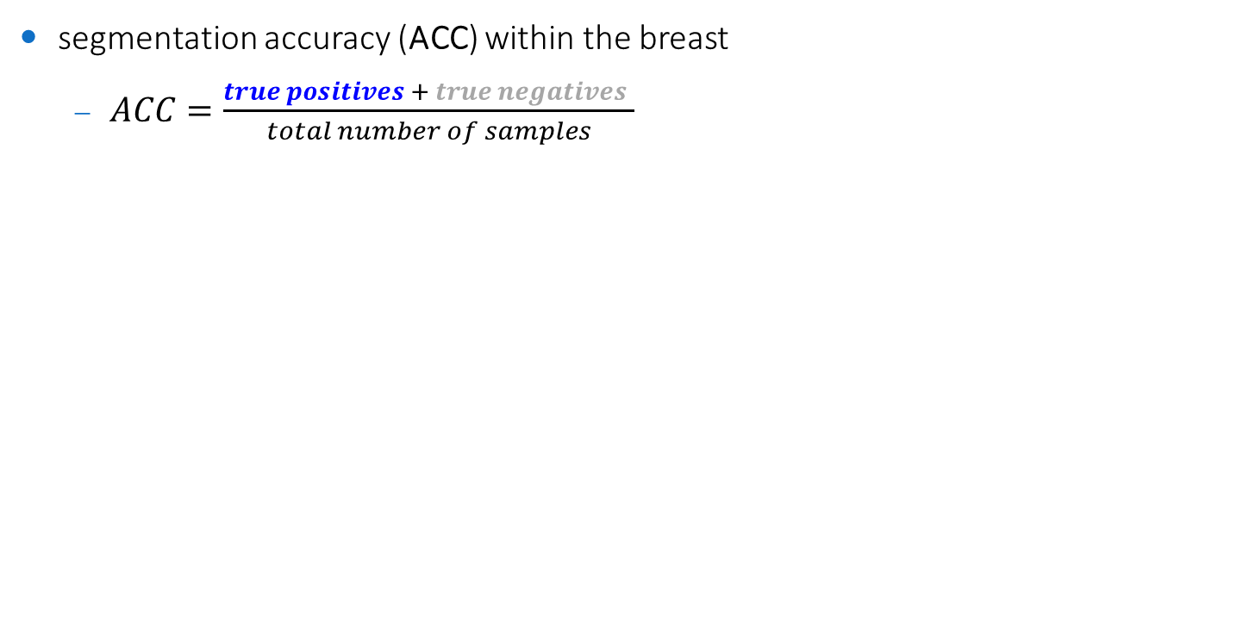
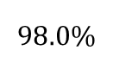
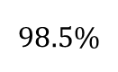
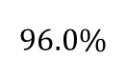
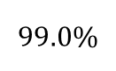
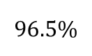
Performance evaluation
segmentation accuracy (ACC) within the breast
$ACC=\frac{true positives + true negatives }{total number of samples}$
$$99.0\%$$
state-of-the-art
$$98.5\%$$
publication level
$$98.0\%$$
excellent
$$97.5\%$$
good
$$97.0\%$$
fair
$$96.5\%$$
fairly adequate
$$96.0\%$$
dummy method

Slide 6
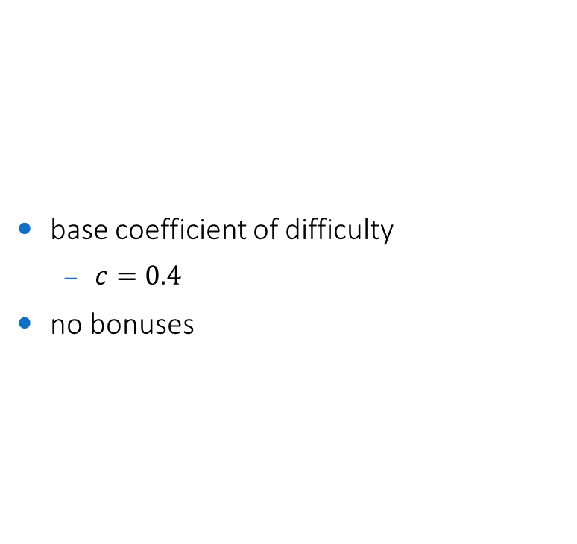
Coefficient of difficulty
base coefficient of difficulty
$c=0.4$
no bonuses

Slide 7
Constraints
implementation in any language/framework
C++/OpenCV suggested (but not mandatory)
reusable module
the code must be commented
it should be super-easy to process another set of images different from the one you used!
same parameters for all the images
unless parameters are self-adjusted on each image
machine learning
optional / not required
if used, use the first half of each dataset for testing, and the second half for training

Slide 8
Code snippets
how to calculate the accuracy?
see /code-snippets/compute-segmentation-accuracy.cpp
how to visually see on the image where the method fails?
see visual evaluation in /code-snippets/compute-segmentation-accuracy.cpp
how to load all images within a folder w/o knowing their file names?
see /code-snippets/load-all-images-within-folder.cpp
an example of pectoral muscle segmentation?
see /code-snippets/example.cpp
based on a fixed triangle in the top-left corner (dummy method)
achieves up to 96.0% accuracy if the corner is finely tuned on (a small subset of) the dataset

Slide 9
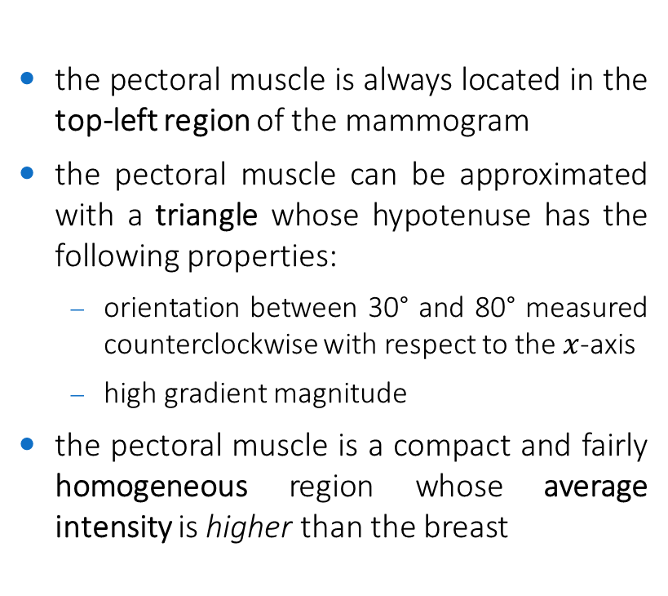


Hints
the pectoral muscle is always located in the top-left region of the mammogram
the pectoral muscle can be approximated with a triangle whose hypotenuse has the following properties:
orientation between 30° and 80° measured counterclockwise with respect to the $x$-axis
high gradient magnitude
the pectoral muscle is a compact and fairly homogeneous region whose average intensity is higher than the breast
$$G$$
$$30°≤α≤80°$$

